Slide 1
How to use PGPLOT

Slide 2
Necessary setting
Insert following files to your program
  Pgplotl.for, pgplot.inc, grpckg1.inc, pgfont.txt
GSview for opening PS file!

Slide 3
Easy starting
program test
integer pgopen
istat=PGOPEN('test.ps/vcps') !PostScript
!-- /c color /v vertical
if(istat<=0)stop 'ERR opening for PS file!'
call pgslw(2)
call pgenv(0.0,6.0,0.0,8.0,1,2) !just,iaxis
call pgmove(0.0,0.0)
call pgdraw(6.0,8.0)
call pgend
end program test

Slide 4
Testing and to see what you plotted in the test.ps

Slide 5
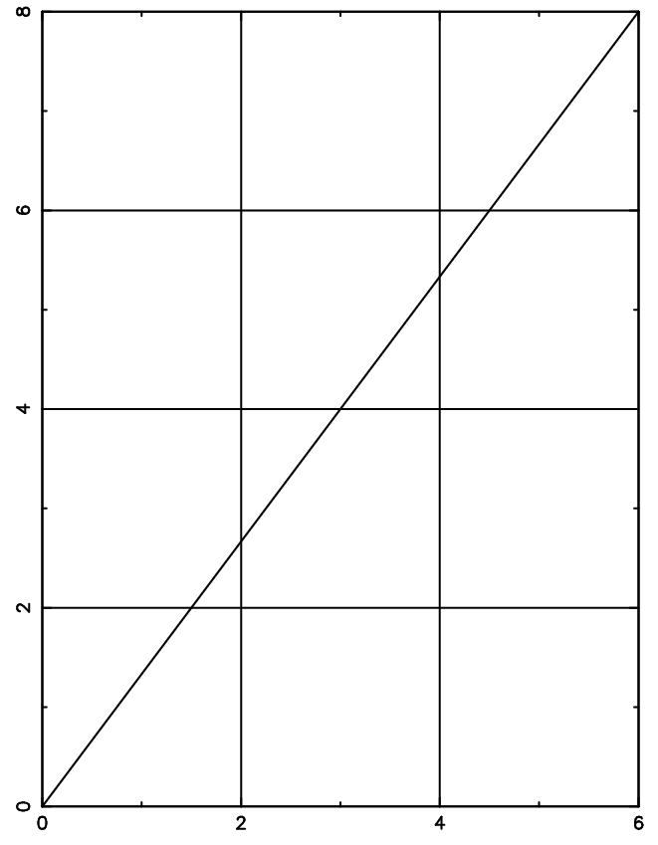

Slide 6
Necessary setting in program
program test
integer pgopen
istat=PGOPEN('test.ps/vcps')
!– open test.ps PS file for vertical A4 size
call pgend
!– close the PS
end program test

Slide 7
PGSLW -- set line width
SUBROUTINE PGSLW (LW)
INTEGER LW
Set the line-width attribute. This attribute affects lines, graph markers, and text. The line width is specified in units of 1/200 (0.005) inch (about 0.13 mm) and must be an integer in the range 1-201.
Argument: LW (input) : width of line, in units of 0.005 inch (0.13 mm) in range 1-201.

Slide 8
PGENV -- set window and view port and draw labeled frame
SUBROUTINE PGENV (XMIN, XMAX, YMIN, YMAX, JUST, AXIS)
REAL XMIN, XMAX, YMIN, YMAX
INTEGER JUST, AXIS

Slide 9
Exercise testing different line width and different just & axis in PGENV

Slide 10
program test
integer pgopen
istat=PGOPEN('test.ps/vcps') !PostScript
if(istat<=0)stop' ERR opening for PS file!'
call pgslw(4)
call pgenv(0.0,8.0,0.0,6.0,1,1) !just,axis
call pgslw(2)
call pgmove(0.0,0.0)
call pgdraw(8.0,6.0)
call pgend
end program test

Slide 11
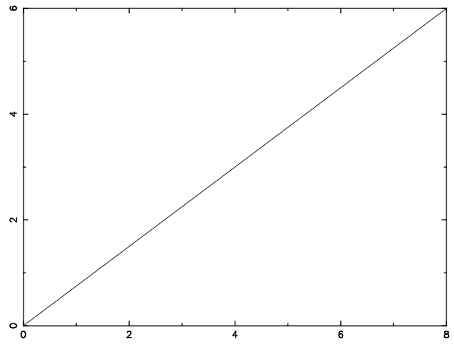

Slide 12
PGMOVE & PGDRAW
Call PGMOVE(X1,Y1)
real x,y !– Pen move to (x1,y1)
Call PGDRAW(X2,Y2)
Draws a line from currently position (x1,y1) to (x2,y2)

Slide 13
program test
integer pgopen
istat=PGOPEN('test.ps/ps') !PostScript
if(istat<=0)stop' ERR opening for PS file!'
call pgslw(4)
call pgenv(0.0,8.0,0.0,6.0,1,1) !just,iaxis
call pgslw(2)
call pgmove(0.0,0.0)
call pgdraw(8.0,6.0)
call pgdraw(3.0,4.0)
call pgdraw(6.0,1.0)
call pgend
end program test

Slide 14
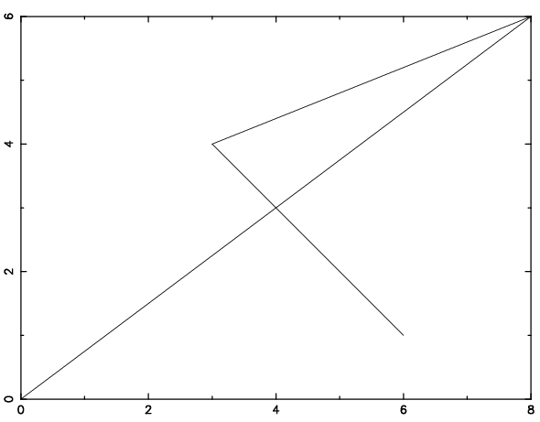

Slide 15
PGLAB -- write labels for x-axis, y-axis, and top of plot
SUBROUTINE PGLAB (XLBL, YLBL, TOPLBL)
CHARACTER*(*) XLBL, YLBL, TOPLBL
XLBL (input) : a label for the x-axis (centered below the view port).
YLBL (input) : a label for the y-axis (centered to the left of the view port, drawn vertically).
TOPLBL (input) : a label for the entire plot (centered above the view port).

Slide 16
program test
integer pgopen
istat=PGOPEN('test.ps/ps') !PostScript
if(istat<=0)stop' ERR opening for PS file!'
call pgslw(4)
call pgenv(0.0,8.0,0.0,6.0,1,1) !just,axis
! Label the axes (note use of \u and \d for raising exponent).
call pglab('X-axis','Y-axis','Title X\u2\d+Y\u2')
call pgend
end program test

Slide 17
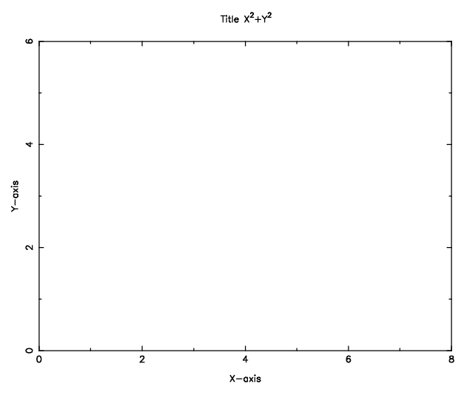

Slide 18
Plot Text
Call PGtext(x,y,’text’)
Example call pgtext(4.,2.,’TEXT’)

Slide 19
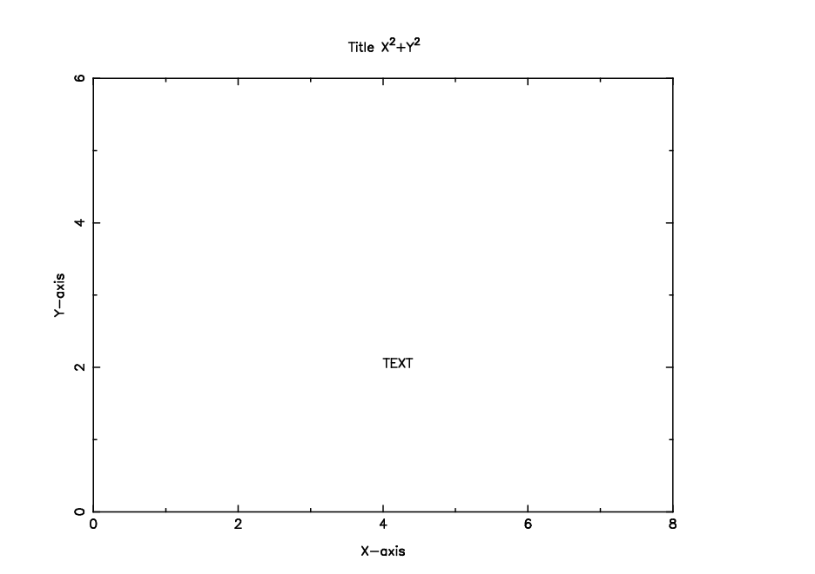

Slide 20
Adjustment of font, color, size
PGSCF -- set character font
PGSCH -- set character height
PGSCI -- set color index

Slide 21
PGSCH -- set character height
SUBROUTINE PGSCH (SIZE)
REAL SIZE Set the character size attribute. The size affects all text and graph markers drawn later in the program. The default character size is 1.0, corresponding to a character height about 1/40 the height of the view surface.
Argument: SIZE (input) : new character size (dimensionless multiple of the default size).

Slide 22
PGSCF -- set character font
SUBROUTINE PGSCF (FONT)
INTEGER FONT Set the Character Font for subsequent text plotting.
Four different fonts are available:
1: (default) a simple single-stroke font ("normal" font)
2: roman font
3: italic font 4: script font

Slide 23
PGSCI -- set color index
SUBROUTINE PGSCI (CI)
INTEGER CI
The assignment of colors to color indices can be changed with subroutine PGSCR (set color representation). Color indices 0-15 have predefined color representations (see the PGPLOT manual), but these may be changed with PGSCR. Color indices above 15 have no predefined representations: if these indices are used, PGSCR must be called to define the representation.

Slide 24
PGSCR
PGSCR -- set color representation
SUBROUTINE PGSCR (CI, CR, CG, CB) INTEGER CI
REAL CR, CG, CB
  Range (0.0-1.0)

Slide 25
example
call pgsch(3.0)
call pgscf(3)
call pgscr(30,0.0,0.0,1.0)
call pgsci(30)
call pgtext(4.,2.,'TEXT')
call pgslw(6)
call pgsci(2)
call pgtext(2.,4.,'TEST2')

Slide 26
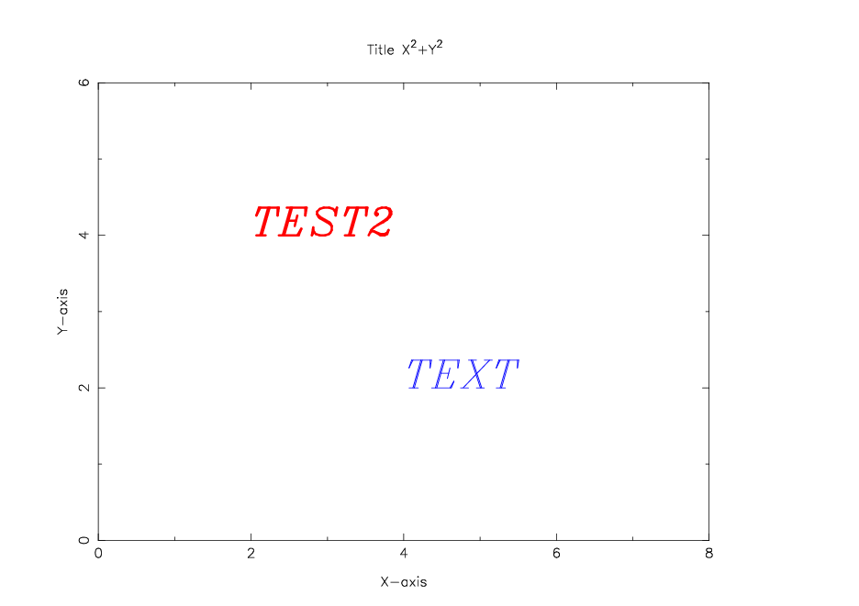

Slide 27
PGPTXT -- write text at arbitrary position and angle
SUBROUTINE PGPTXT (X, Y, ANGLE, FJUST, TEXT)
REAL X, Y, ANGLE, FJUST
CHARACTER*(*) TEXT
If FJUST = 0.0, the string will be left-justified at the point (X,Y); if FJUST = 0.5, it will be centered, and if FJUST = 1.0, it will be right justified.

Slide 28
Example
Call PGPTXT(2.,2.,45.0,0.0,’TEST’)
call pgsch(3.0)
call pgscf(3)
call pgscr(30,0.0,0.0,1.0)
call pgsci(30)
call pgtext(4.,2.,'TEXT1')
call pgslw(6)
call pgsci(2)
call pgtext(2.,4.,'TEST2')
Call PGPTXT(2.,2.,45.0,0.0,’TEST3’)

Slide 29
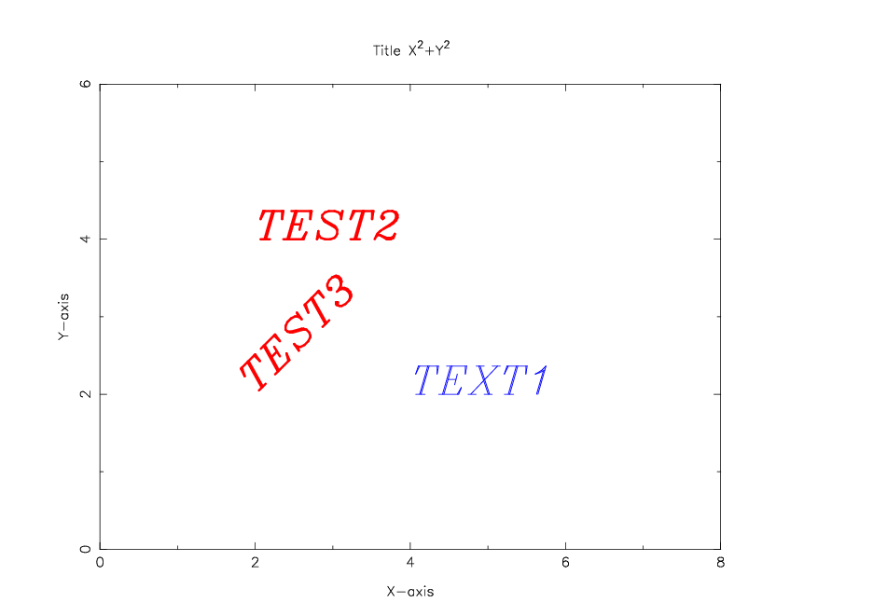

Slide 30
Plot Line
PGLINE -- draw a polyline (curve defined by line-segments)
SUBROUTINE PGLINE (N, XPTS, YPTS)
  INTEGER N
  REAL XPTS(*), YPTS(*)

Slide 31
Example
program test
integer pgopen
real x(1000),y(1000)
pi=3.141592654
istat=PGOPEN('test.ps/cps') !PostScript
if(istat<=0)stop' ERR opening for PS file!'
do i=1,1000
x(i)=i/100.0
y(i)=sin(2*x(i)/pi)*cos(4*x(i)/pi)
enddo
call pgsci(1)
call pgslw(4)
call pgsch(2.0)
call pgscf(3)
call pgenv(0.0,10.0,-1.0,1.0,0,1) !just,axis
! Label the axes (note use of \u and \d for raising exponent).
call pglab('Time (sec)','Amplitude','Plot Testing')
call pgslw(2)
call pgsci(2)
call pgline(1000,x,y)
call pgend
end program test

Slide 32
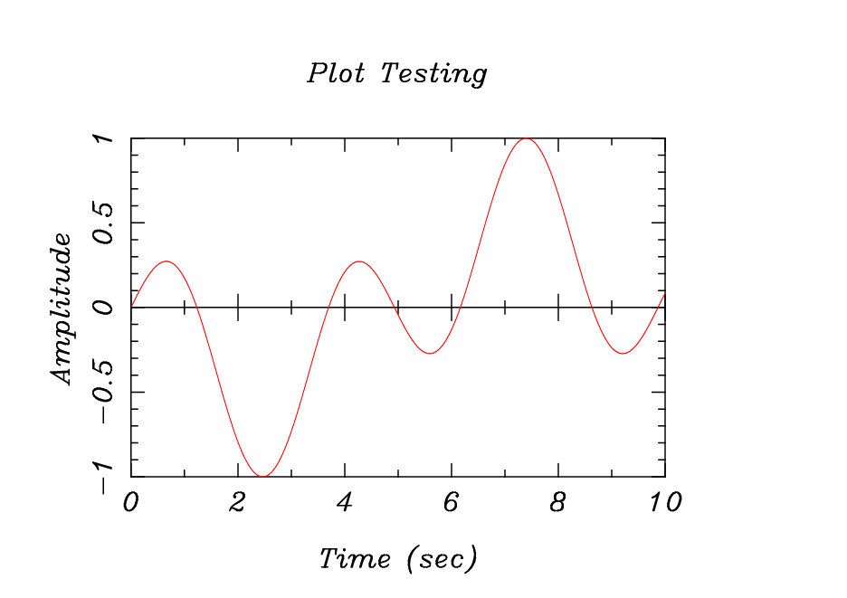

Slide 33
PGSUBP -- subdivide view surface into panels
SUBROUTINE PGSUBP (NXSUB, NYSUB)
INTEGER NXSUB, NYSUB

Slide 34
pgsubp
NXSUB=3, NYSUB=2
  123
  456
NXSUB=-3, NYSUB=2
  135
  246

Slide 35
Example
call pgsubp(2,2)
do i=1,4
call pgsci(1)
call pgslw(4)
call pgsch(2.0)
call pgscf(3)
call pgenv(0.0,10.0,-1.0,1.0,0,1) !just,axis
! Label the axes (note use of \u and \d for raising exponent).
call pglab('Time (sec)','Amplitude','Plot Testing')
call pgslw(2)
call pgsci(2)
call pgline(1000,x,y)
enddo

Slide 36
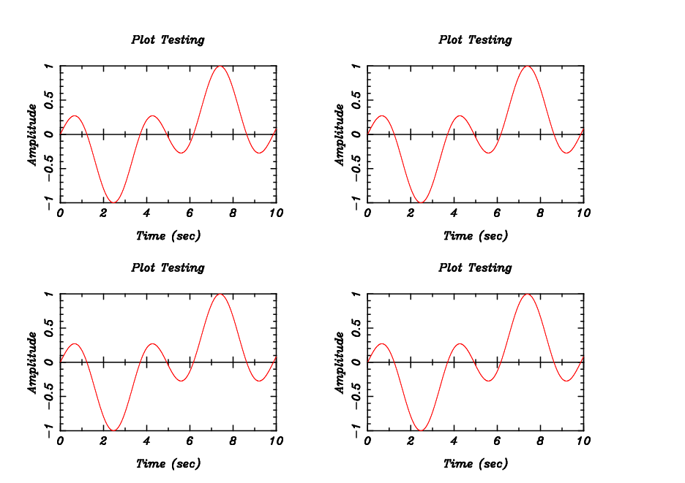

Slide 37
Homework PGplot 1
Please read waveform from seisdata.txt and plot it!
Using PGPLOT plot three component waveform and mark the Peak value!

